Slide 1
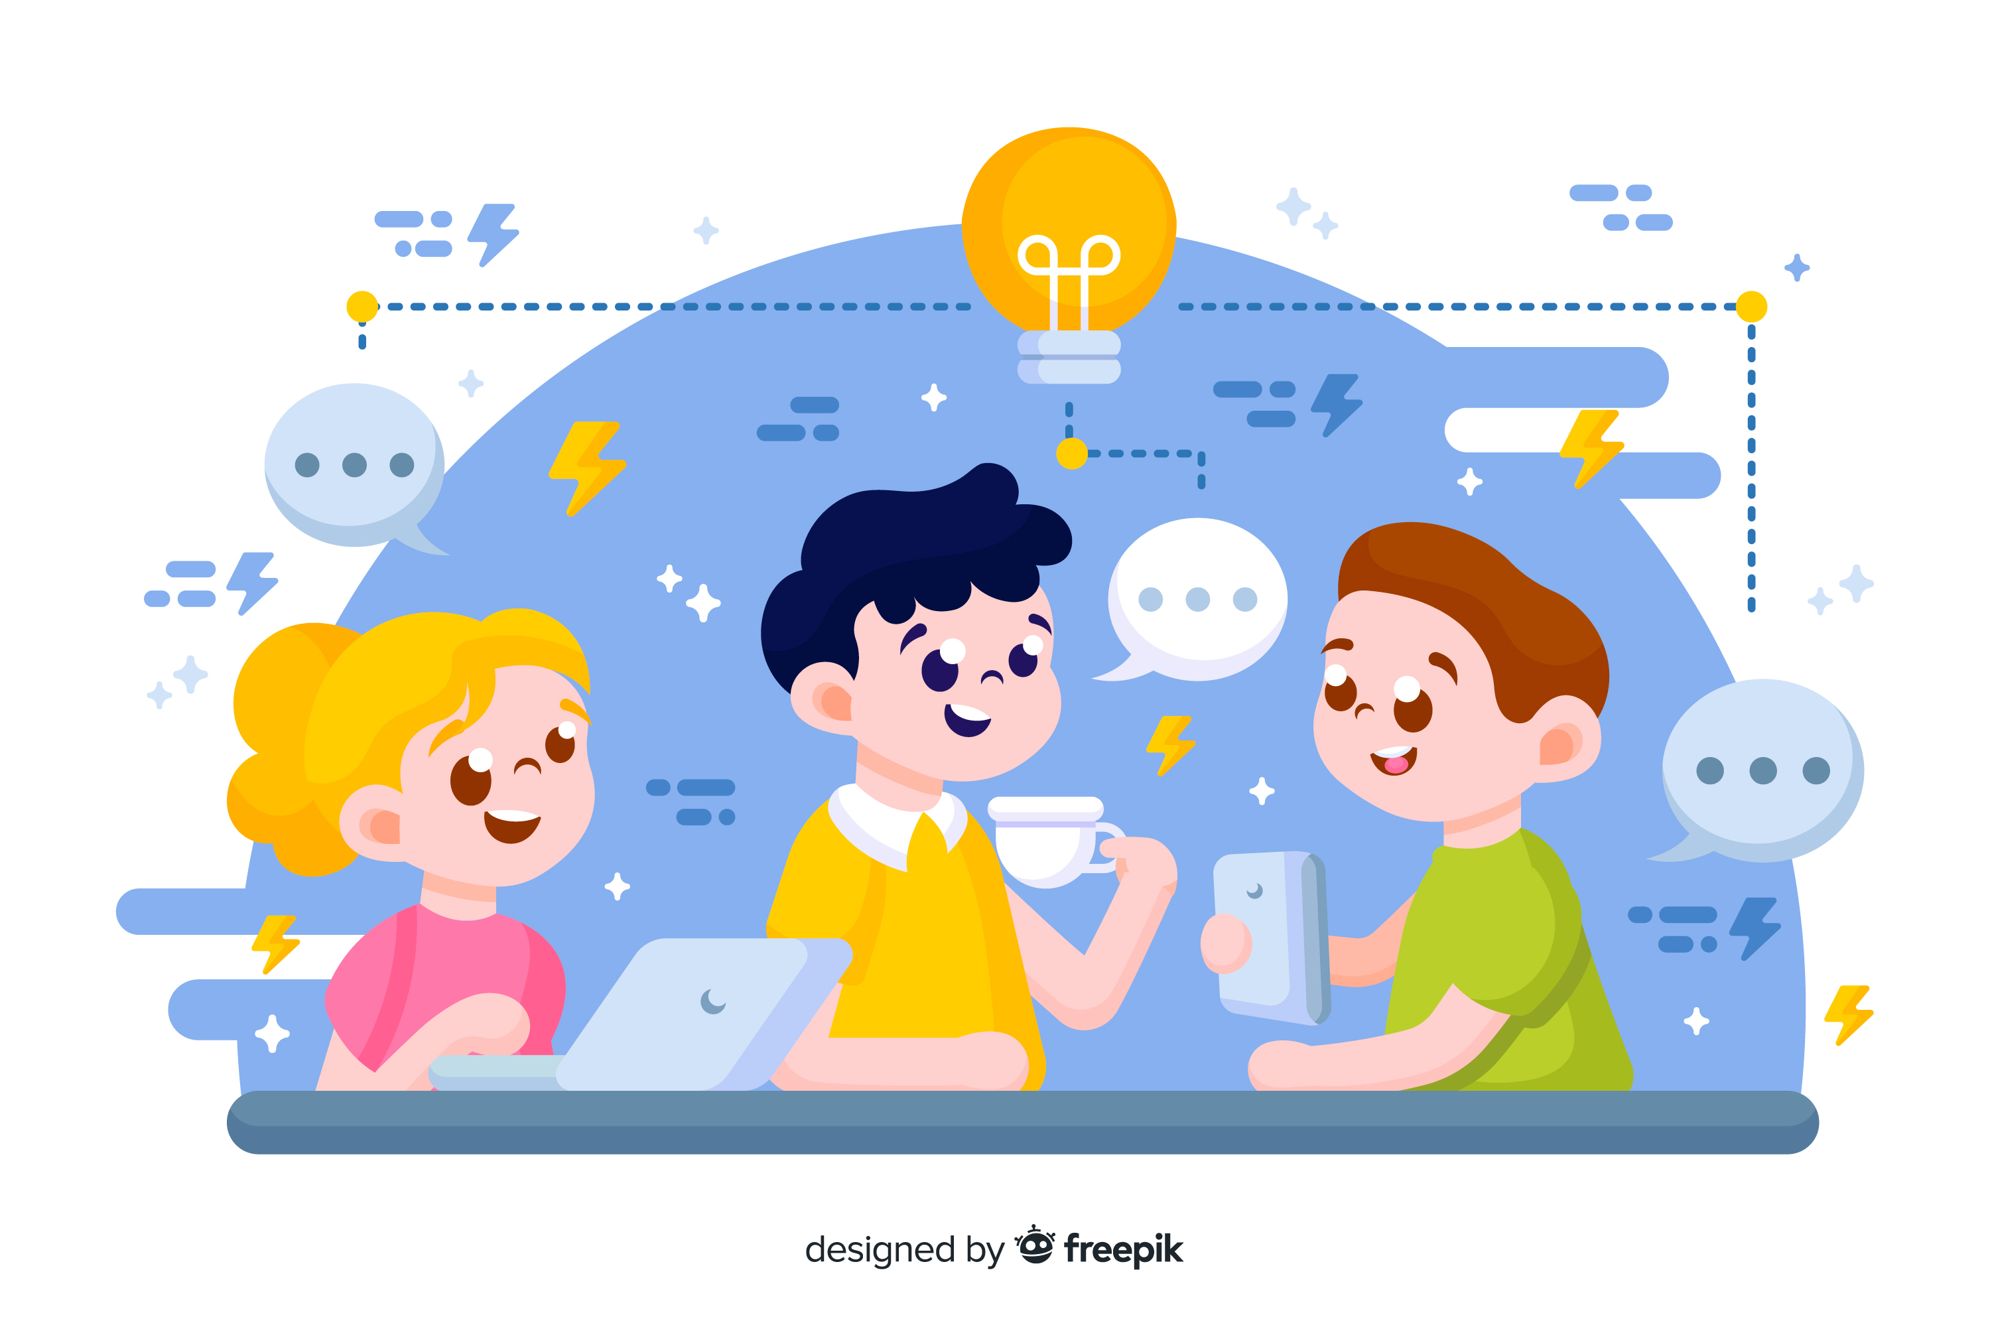
Learn Programming For Kids (Python)

Slide 2
Lesson 10
Fun Activities – Python Projects for Kids

Slide 3
13. Python Projects for Kids
To make learning Python more exciting, here are a few project ideas for kids:

Slide 4
Project 1. Simple Calculator

Slide 5
Project Description:
Create a simple calculator which can perform basic arithmetic operations like addition, subtraction, multiplication, or division depending upon the user input. Approach :
User chooses the desired operation. Options 1, 2, 3, and 4 are valid.
Two numbers are taken and an if…elif…else branching is used to execute a particular section.
Using functions add(), subtract(), multiply() and divide() evaluate respective operations.

